Slide 1

PROJECT TITLE
DEGREE / SEMESTER
Group Member Name 1, [Roll No]
Group Member Name 2, [Roll No]
Group Member Name 3, [Roll No]
Notes:
Remember to keep your slides simple and easy to read. Use visuals to help illustrate your points, and use bullet points to keep text to a minimum. Make sure your font is large enough to be easily read from the back of the room. And most importantly, practice your presentation so you feel confident and comfortable on the day.
Cover Slide:
This slide should introduce your topic and include the title of your presentation and your name.

Slide 2
Contents / Agenda
Introduction
Problem Statement
Motivation
Objectives
Features
Platform (Development Environment)
Proposed Timeline [Gantt Chart]
Business Model [for Final Year Student Only]
Conclusion
Notes:
Content/Agenda:
On this slide, provide a quick overview of what your presentation will cover. This will help your audience understand what to expect.

Slide 3
Introduction [FONT-SIZE: 36pts]
Level 1 : font size 24 pts
Level 2: font size: 22 pts (if required)
Notes:
Introduction
Explain why this topic is important to you and to your intended audience.
What we present here
Providing a brief overview of the project idea
Describing the scope and goals of the project
Introducing the project team members and their roles

Slide 4
Problem Statement [FONT-SIZE: 36pts]
Level 1 : font size 24 pts
Level 2: font size: 22 pts (if required)
Notes:
Problem Statement
Explain the problem you are trying to solve or the opportunity you are trying to seize. Use data or statistics to support your claims.
What we present here
Identifying the problem that the project aims to solve
Providing background information and context for the problem
Highlighting the importance and impact of the problem on the target audience or stakeholders

Slide 5
Motivation [FONT-SIZE: 36pts]
Level 1 : font size 24 pts
Level 2: font size: 22 pts (if required)
Notes:
Motivate
Explain why this problem or opportunity is important to you and to your intended audience. Use examples or stories to illustrate your point.
What we present here
Explaining the reason behind selecting this project idea
Discussing the potential benefits and outcomes of the project
Identifying any existing solutions or alternatives and their limitations

Slide 6
Objective [FONT-SIZE: 36pts]
Level 1 : font size 24 pts
Level 2: font size: 22 pts (if required)
Notes:
Objectives
Explain your project objectives, including any specific goals you have set for yourself or your team. Be sure to explain how you will measure success.
What we present here
Defining the objectives of the project in terms of outcomes and impact
Providing a clear and measurable definition of success for the project
Outlining the target audience or stakeholders of the project and their needs

Slide 7
Features [FONT-SIZE: 36pts]
Level 1 : font size 24 pts
Level 2: font size: 22 pts (if required)
Notes:
Features
Describe the key features of your proposed solution. Use visuals or diagrams to help illustrate how it works.
What we present here
Describing the key features and functionalities of the project
Discussing any unique or innovative aspects of the project
Outlining the expected deliverables and outcomes of the project

Slide 8
Platform/Dev. Environment
Level 1 : font size 24 pts
Level 2: font size: 22 pts (if required)
Notes:
Platform / Development Environment
Explain the development environment you will be using to build your solution. Discuss any key tools or technologies you will be using.
What we present here
Identifying the programming language and development tools used for the project
Discussing any relevant technical requirements or constraints
Outlining the testing and debugging strategies for the project

Slide 9
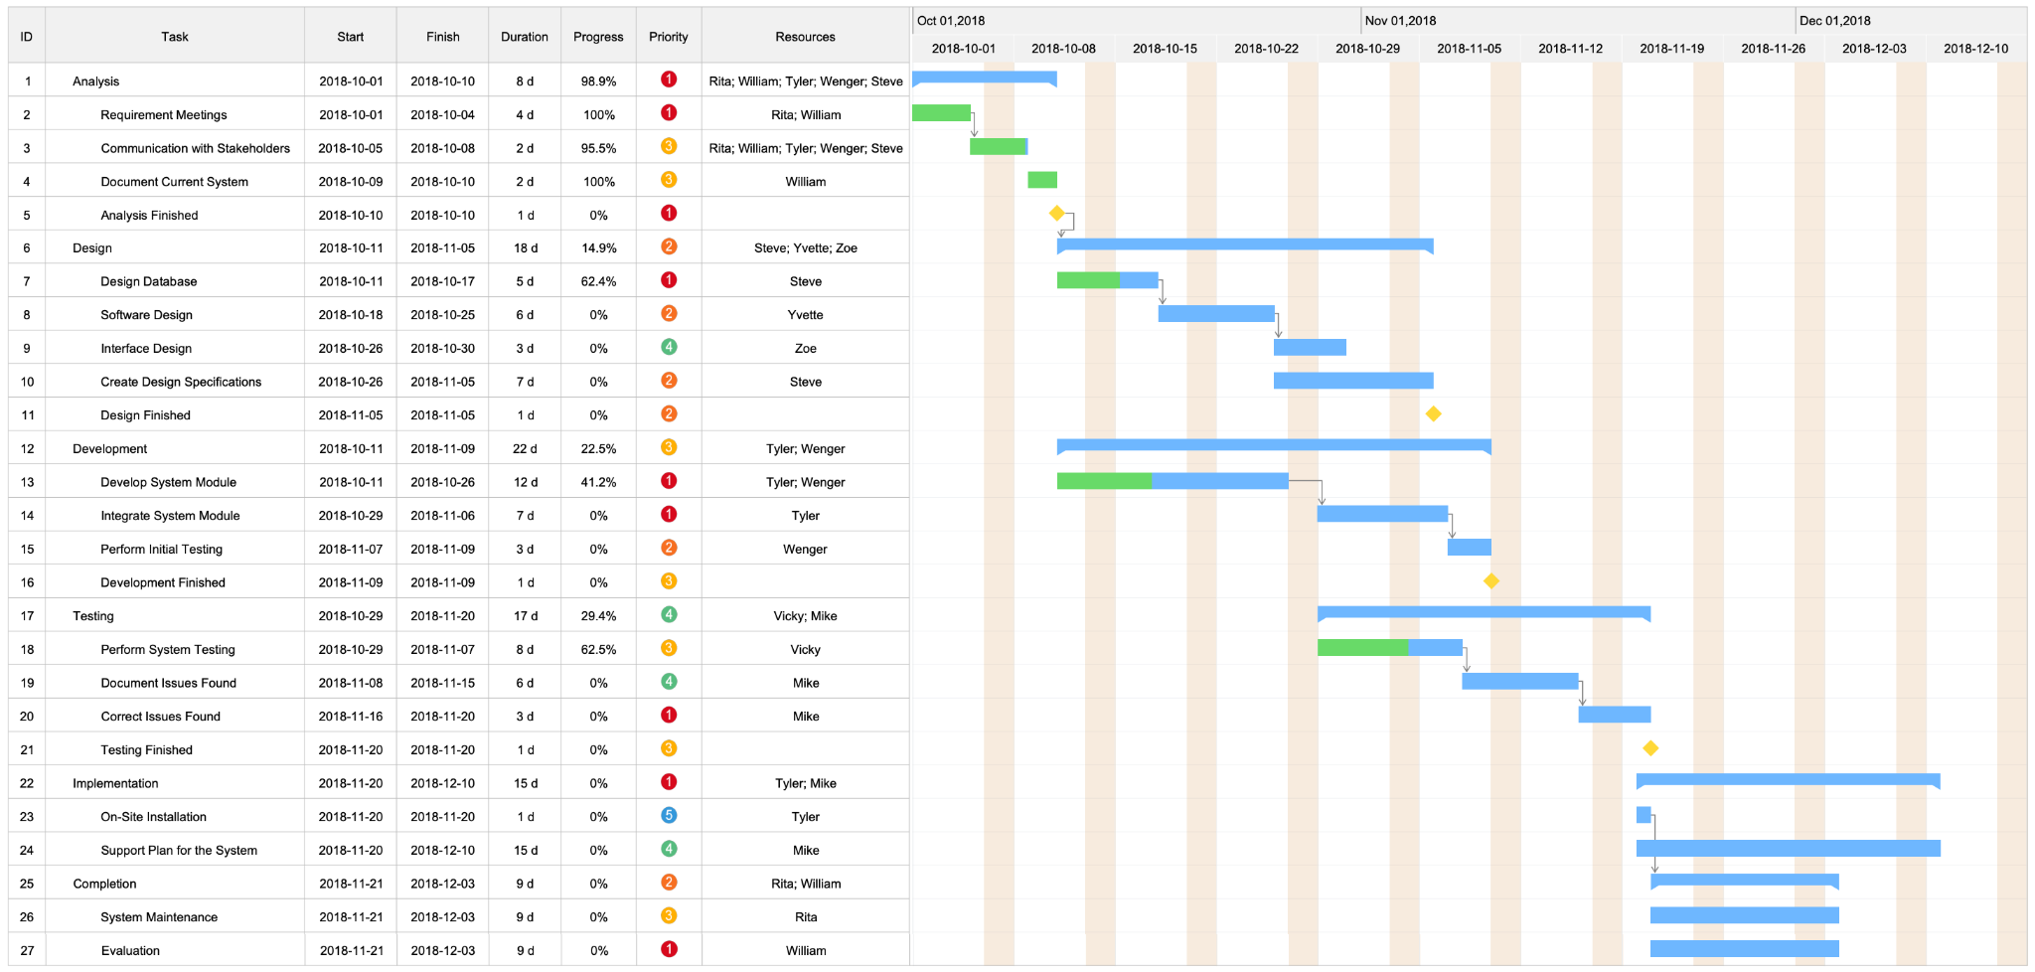
Planned Timeline/Gantt Chart
Notes:
Planned Timeline / Gantt Chart (Roadmap)
Use a Gantt chart or similar tool to illustrate your proposed timeline. Be sure to include key milestones and deadlines.
What we present here
Creating a Gantt chart to show the proposed timeline for the project
Breaking down the project into manageable tasks and milestones
Identifying any critical path or dependencies in the project timeline

Slide 10
Business Model [for Final Year Project Only]
Level 1 : font size 24 pts
Level 2: font size: 22 pts (if required)
Notes:
Business Model (Marketing and sales plan)
Explain your proposed business model, including your revenue streams, customer segments, and distribution channels.
What we present here
Discussing the potential revenue streams or cost savings generated by the project
Outlining the target market or customers for the project
Identifying any partnerships or collaborations necessary for the project's success

Slide 11
Conclusion [FONT-SIZE: 36pts]
Level 1 : font size 24 pts
Level 2: font size: 22 pts (if required)
Notes:
Conclusion
Summarize your presentation and emphasize why your proposed solution is important. Thank your audience for their time.
What we present here
Summarizing the main points of the project proposal
Reiterating the relevance and significance of the project
Request for feedback and suggestions for improvement.

Slide 12
Questions/Queries…
Notes:
Question/Queries will be made by the evaluation team after the end of presentation

